Slide 1
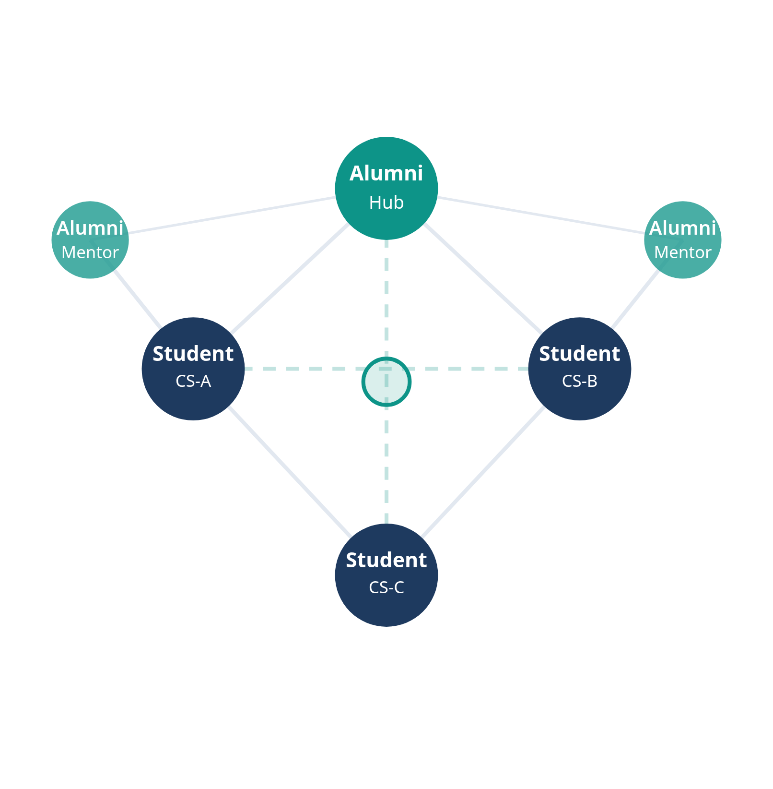
Alumni Connect
PROJECT PRESENTATION
2026
Connection Network
STUDENT-ALUMNI NETWORKING
Alumni Connect
Bridging the gap between students and alumni for
networking, mentorship, and placement support within
educational institutions.
DEPARTMENT
PROJECT TYPE
Computer Science
& Engineering
Web App
Full-Stack
Alumni
Students
Alumni Connect — CSE Project 2026
Academic Project
•
Slide 1 of 6

Slide 2
Alumni Connect
ABSTRACT
2026
PROJECT OVERVIEW
01
Web-Based Platform
What is Alumni
Connects current students and institutional alumni through a unified digital
ecosystem
Connect?
02
Interest-Driven Connections
Enables connections based on shared interests, skills, and organizations
for meaningful engagement
A web-based platform designed to bridge the gap between
current students and institutional alumni through structured,
interest-driven connections.
03
Mentorship & Placement Support
Facilitates career guidance and placement support within a structured
digital ecosystem
CORE PURPOSE
Connect students and alumni based on shared interests,
skills, and organizations to enable mentorship, guidance, and
placement support.
04
Solves Fragmented Records
Addresses the challenge of siloed alumni records and lack of a unified
institutional networking channel
Alumni Connect — CSE Project 2026
Academic Project
•
Slide 2 of 6

Slide 3
Alumni Connect
PROBLEM STATEMENT
2026
THE CHALLENGE
Key Pain Points
A Gap in Institutional
Siloed Alumni Records
Networking
Institutions maintain alumni data in outdated, fragmented systems
No Direct Student Channel
Students lack a direct way to reach relevant alumni for guidance or referrals
Educational institutions maintain alumni data in isolated, outdated
systems. Neither students nor alumni have a structured, trusted
channel to connect with each other.
No Alumni Give-Back Mechanism
Alumni have no structured way to stay engaged or contribute to their
institution
Generic Networks Lack Context
Platforms like LinkedIn lack the institutional trust and academic context
needed
NET RESULT
Missed mentorship opportunities, poor placement rates, and
weak alumni engagement across institutions.
Missed Opportunities
Weak alumni engagement leads to poor placement rates and lost mentorship
potential
Alumni Connect — CSE Project 2026
Academic Project
•
Slide 3 of 6

Slide 4






Alumni Connect
PROPOSED FUNCTIONALITIES
2026
CORE FEATURES
Platform Capabilities
Smart Profile Matching
Mentorship Requests
Alumni Directory
Connect students and alumni based on shared skills,
interests, and domain areas using intelligent
matching algorithms
Students send formal mentorship invitations with
defined goals; alumni accept and track sessions
Searchable, filterable directory of alumni by batch,
field of work, and geographic location
Discussion Forums
Job & Internship Board
Events & Webinars
Topic-based community boards for career advice,
knowledge sharing, and peer discussions
Alumni post exclusive job and internship
opportunities for current students at their institution
Institutional events, alumni reunions, and guest
lectures organized in a shared calendar
Alumni Connect — CSE Project 2026
Academic Project
•
Slide 4 of 6

Slide 5
Alumni Connect
TOOLS & TECHNOLOGIES
2026
DATA & INFRASTRUCTURE
APPLICATION STACK
DATABASE
MongoDB
NoSQL
FRONTEND
Alumni profiles, posts, connections
React.js
UI Library
Tailwind CSS
Styling
AUTHENTICATION
JWT-Based Auth
BACKEND
Secure login with institutional email verification
Node.js
Runtime
Express.js
Framework
SEARCH & MATCHING
Elasticsearch
Skill-based profile discovery and full-text search
VERSION CONTROL & DEVOPS
Git & GitHub
AWS / Render
DEPLOYMENT
AWS / Render
CI/CD Pipeline
Alumni Connect — CSE Project 2026
Academic Project
•
Slide 5 of 6

Slide 6

Alumni Connect
EXPECTED OUTCOME
2026
Functional Networking Platform
A fully functional alumni-student networking platform tailored to institutional needs
PROJECT DELIVERABLE
Improved Placement Rates
What We Will
Increased placement success through direct alumni referrals and exclusive job postings
Achieve
Active Mentorship Ecosystem
Connecting students with domain experts for structured guidance and career development
A fully functional, scalable alumni-student networking
platform tailored to institutional needs — ready for
real-world deployment.
Stronger Alumni Engagement
Higher alumni participation and stronger institution community bonds through structured
give-back channels
SCALABILITY
Multi-department and multi-institution deployment
ready
Scalable Architecture
Ready for multi-department and multi-institution deployment with minimal configuration changes
Alumni Connect — CSE Project 2026
Academic Project
•
Slide 6 of 6

